Slide 1
Sales Analysis Dashboard
DataX Labs| Data Analyst Internship - Task3
DataX Labs
By-Samruddhi Patil

Slide 2
Objective & Dataset
- Build interactive dashboard to analyze sales performance for business stakeholders
- Dataset: Superstore Sales Data from Kaggle
- Records: 9,994 | Columns: 21 | Period: 2014-2017
- Tools Used: Power BI, DAX
- Key KPIs: Total Sales, Profit, Quantity, Discount

Slide 3
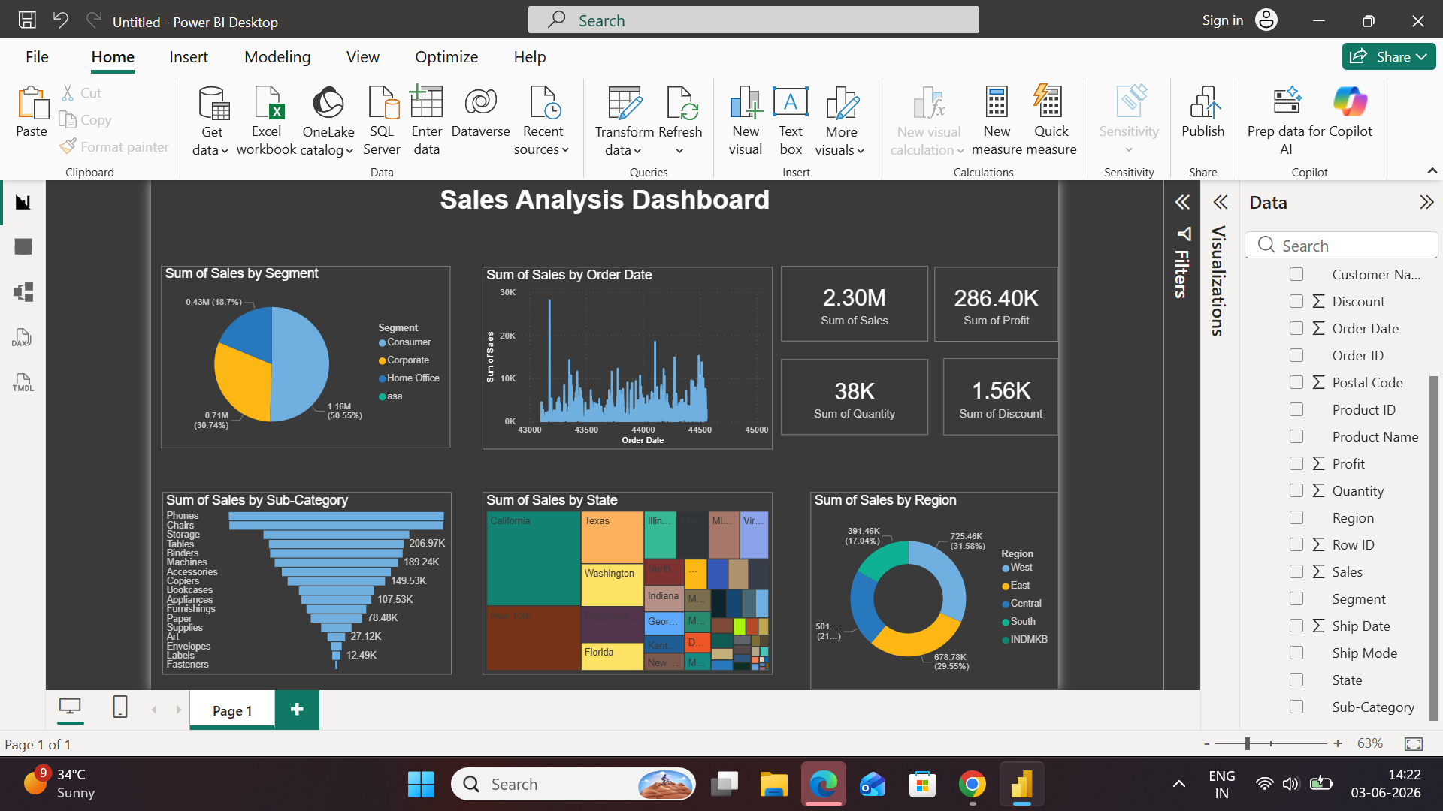
Dashboard Overview
- Interactive KPIs: Total Sales $2.3M, Profit $286K, Orders 5K+, AOV $458
- Key Filters: Region, Segment, Category, Year for dynamic analysis
- Top Visuals: Sales by Region, Profit by Segment, Monthly Sales Trend
- Drill-down: Category → Sub-Category analysis enabled

Slide 4
Key Insights & Recommendation
- West Region dominates sales with 31.58%, while South lags at 15.64% growth opportunity
- Consumer segment contributes 50.56% of total sales, making it the key revenue driver
- Phones, Chairs & Storage are top-performing sub-categories; Tables & Bookcases underperform
- California, Texas & New York are highest contributing states - focus marketing efforts here
- Recommendation: Review discount strategy as $1.56K discount only yielded $286K profit on $2.30M sales

Slide 5
Thank You
Samruddhi Patil
Data Analyst Intern
samruddhip009@gmail.com

